Slide 1
QUEUE

Slide 2
What Is Queue?
A queue is an ordered list which insertion are done at one end (rear) and deletion at another end (front).
The first element to be inserted is the first one to be deleted.
It is called First In First Out (FIFO) or Last In Last Out (LILO).

Slide 3
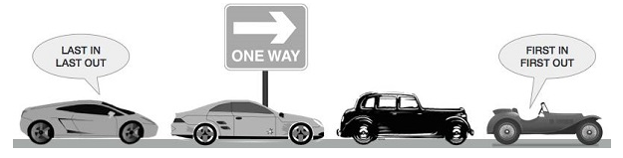
Queue In Real-World

Slide 4
Queue Concepts
When an element is inserted in a queue, it is called En-Queue.
When an element is removed from the queue, it is called De-Queue.
De-Queuing an empty queue is called underflow (treats as Exception).
En-Queuing an element in a full queue is called overflow (treats as Exception).

Slide 5
Queue Implement
We need a data structure that will store the elements of queue. We can use an array to store it.
Example: let items = [];

Slide 6
Declare Methods In Queue
En-queue(element(s)): this added a new item (or several items) at the back of the queue.
De-queue(): this removed the first item from the queue (the item that is in the front of the queue). It also return the removed element.
Front(): this return the first element from the queue, the first one added and the first one that removed from the queue.
isEmpty(): this return true if the queue does not contain any elements, and false if the queue is bigger than 0.
Size(): this return the number of elements the queue contains. It is similar length property of the array.

Slide 7
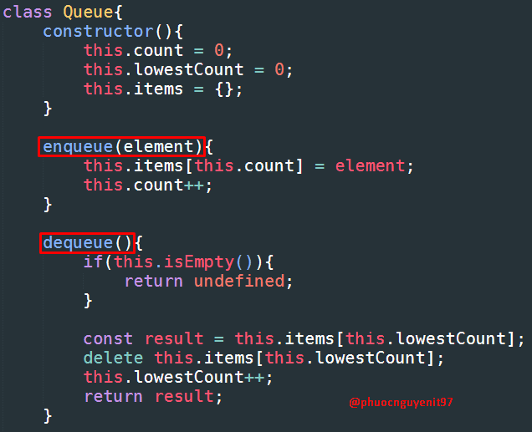
Queue Implement By Code

Slide 8
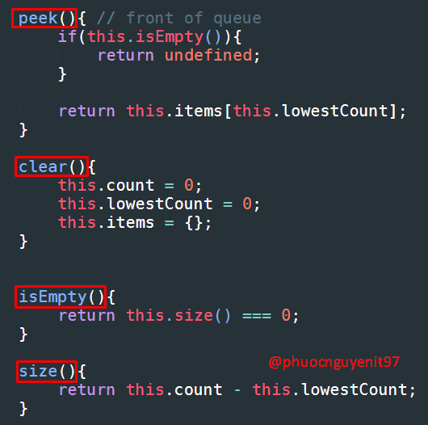
Queue Implement By Code

Slide 9
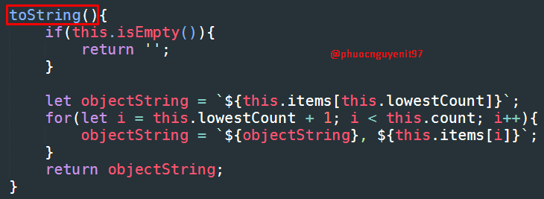
Queue Implement By Code

Slide 10
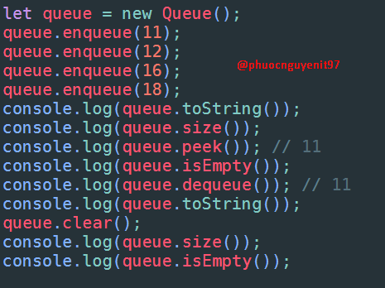
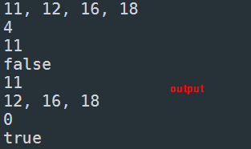
Using Queue

